Slide 1

Statistical Computation Methods for Data Science
Unit-II
Lecture - 5
S U RAVI KUMAR CHAVALI
Assistant Professor
Department of Science and Humanities
SNIST

Slide 2
We discuss the following in today’s Lecture
Qualitative predictors
Predictors with Only Two Levels
Qualitative Predictors with More than Two Levels
Examples

Slide 3
Qualitative predictors
Sometimes it is necessary to include a categorical (or qualitative) variable into the regression equation since the qualitative variable may play a significant role in the prediction or explanation of the dependent variable.
Qualitative variables : Numerical measurements on the phenomena of interest are not possible. Rather, the observations are categorical.
Qualitative variables are important in regression analysis because they provide more flexibility in modeling.

Slide 4
Qualitative predictors
e.g. gender (female, male), Company status (private, public), Treatment (yes, no), blood pressure rating (low, average, high) etc.
Whether someone has a college degree or not may influence the salary the person gets.
The location of a house (rural, urban) can change its value.
The season (winter, summer, rainy) can be used in predicting the number of flights arriving in some airport.

Slide 5
Qualitative predictors
Whether a company is public or private may have a role in explaining its exports level.
An easy way of incorporating a qualitative variable into a regression model is by representing them with special types of variables called dummy variables.

Slide 6
Qualitative predictors
A dummy variable is a variable that indicates the presence or absence of some characteristics or attribute. The dummy variable assumes the value 1 if the attribute is present and the 0 if the attribute is absent.
For example, a variable denoting gender can be quantified as female = 1 and male = 0 or vice versa.
Dummy variables are also called indicator variables, categorical variables, or binary variables and qualitative variables.

Slide 7
Qualitative predictors
If an intercept is included in the model and if a qualitative variable has m categories, then introduce only (m – 1) dummy variables.
For example, gender has only two categories; hence we introduce only one dummy variable for gender.
If we consider self-reported health as a choice among excellent, good, and poor, we can have at most two dummy variables to represent the three categories.
Note: If we do not follow this rule, we will fall into what is called the dummy variable trap, the situation of perfect collinearity.

Slide 8
Predictors with Only Two Levels:
For example, based on the gender variable, we can create
a new variable that takes the form
and use this variable as a predictor in the regression equation. This results in the model
(Ex:

Slide 9
Predictors with Only Two Levels:
Now β₀ can be interpreted as the average credit card balance among males.
β₀ + β₁ as the average credit card balance among females, and
β₁ as the average difference in credit card balance between females and males.

Slide 10
Predictors with More than Two Levels:
When a qualitative predictor has more than two levels, a single dummy variable cannot represent all possible values.
In this situation, we can create additional dummy variables. For example we create two dummy variables.
First Second

Slide 11
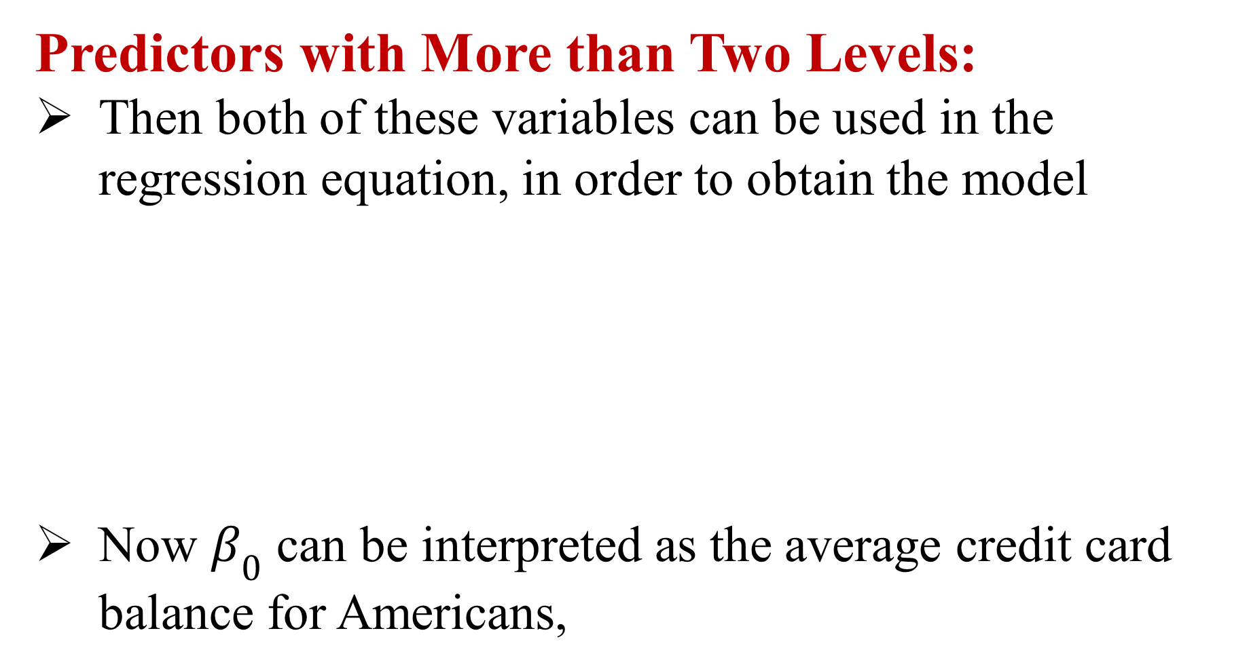
Predictors with More than Two Levels:
Then both of these variables can be used in the regression equation, in order to obtain the model
Now $β_{0}$ can be interpreted as the average credit card balance for Americans,

Slide 12
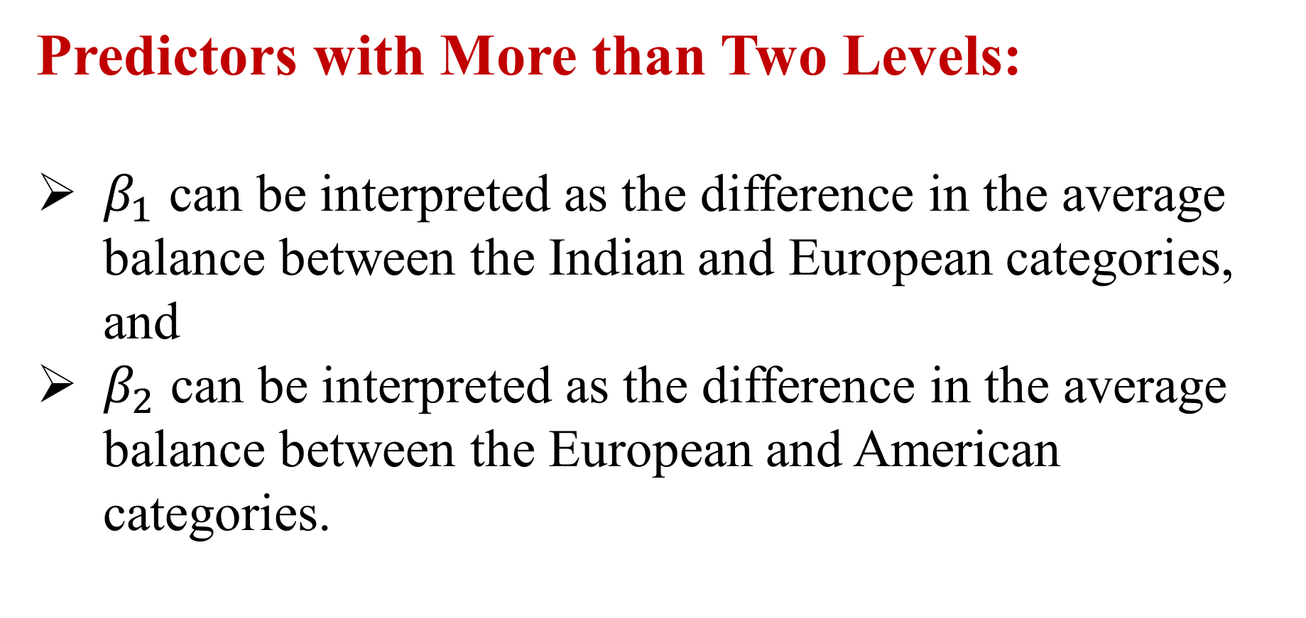
Predictors with More than Two Levels:
$β_{1}$ can be interpreted as the difference in the average balance between the Indian and European categories, and
$β_{2}$ can be interpreted as the difference in the average balance between the European and American categories.

Slide 13
Example : 1
Certain kind of drug is suspected of raising blood pressure. We suppose randomly selected 10 women's, in that 6 take drug and 4 do not take the drug. What is the regression line of the following data.
B.P | 85 | 95 | 90 | 75 | 100 | 90 | 90 | 90 | 100 | 85
Drug | No | Yes | Yes | No | Yes | No | No | Yes | Yes | Yes

Slide 14
Example : 1 Solution
SUMMARY OUTPUT
Regression Statistics
R Square | 0.333333
Standard Error | 6.454972
Observations | 10
 | Coefficients | Standard Error | t Stat
Intercept | 85 | 3.227486 | 26.33629
X Variable 1 | 8.333333 | 4.166667 | 2

Slide 15
Recapitulation:
Qualitative predictors
Predictors with Only Two Levels
Qualitative Predictors with More than Two Levels
Examples

Slide 16
THANK YOU
Notes:
16

